Slide 1
Fine Tuning LLM
Step by Step Guide

Slide 2
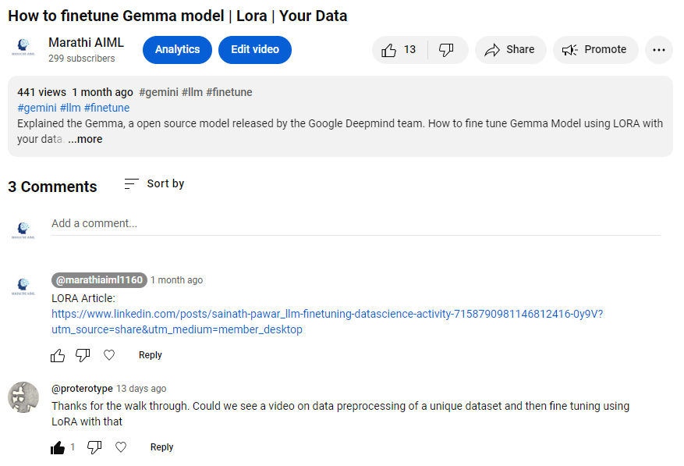

Slide 3
What LLM Fine Tuning?
Fine-tuning is a process where a pre-trained model is further trained on a smaller, task-specific dataset. This adjustment helps the model specialize in a particular task, making it more accurate and effective in handling specific types of data and questions.
Pretraining initializes the model’s understanding of the data and its structure.

Slide 4
Key Steps :
Select pre-trained model - Align with your desired Architecture and Functionalities
Gather Relevant Dataset - Relevant to our task (Label Dataset)
Preprocess Dataset - Clearing, Splitting, (Train, Test, Validation)
Fine Tuning - Allowing the model to adapt & specialised for that context
Task Specific Adaptation - Generate content relevant to specific task ex. Sentiment analysis, NER, Summarization, translation etc.

Slide 5
Fine Tuning Method
Full FT (Instruction FT) - Updates all model weights, Creating a new version. Require sufficient memory and computation resource similar to pre training. To handle preprocessing of gradient, optimizers and other components.
PEFT(Parameter efficient training) - Updates on subset of parameters, “freezing a rest”. Reduced the number of trainable parameter. Maintained original LLM weights.

Slide 6
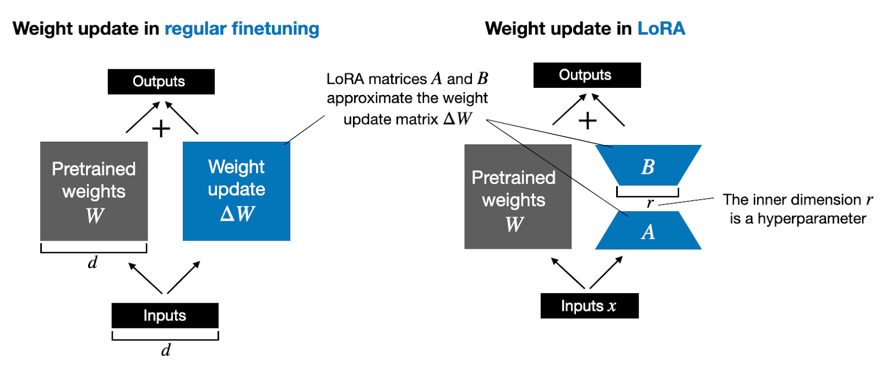
LORA

Slide 7
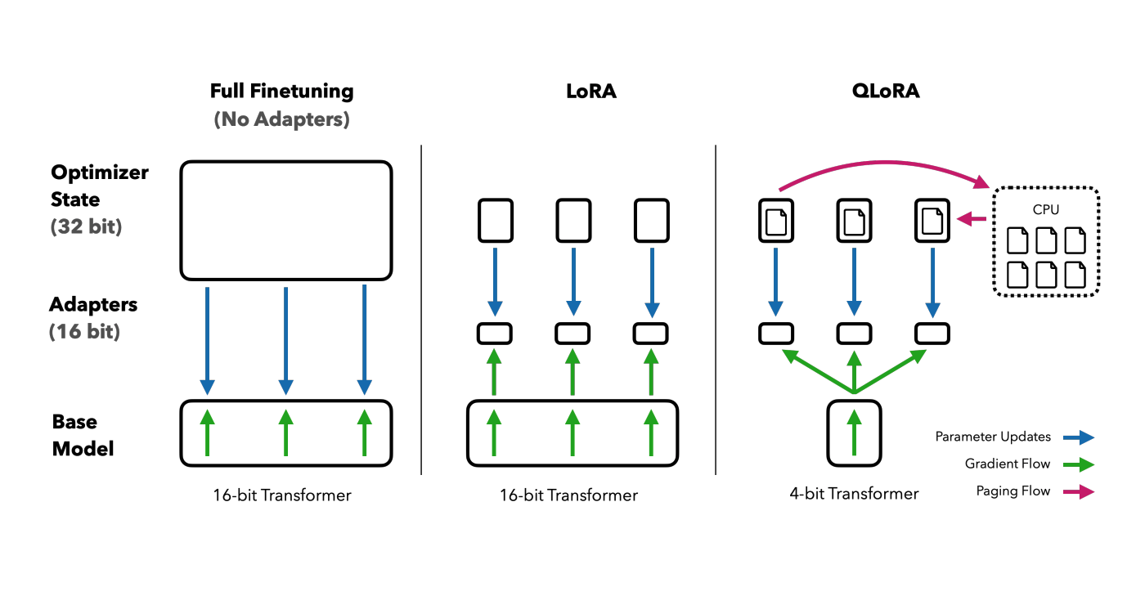
QLORA

Slide 8
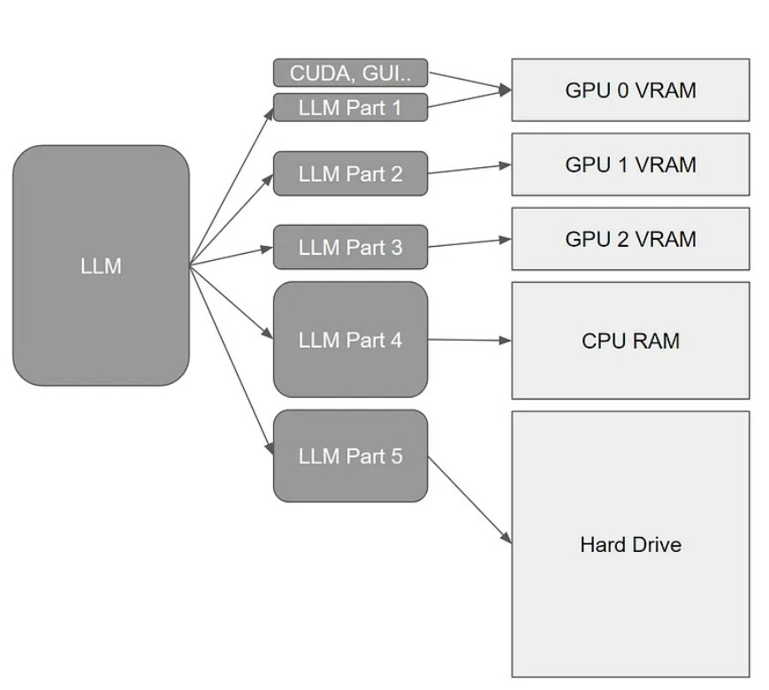
device_map

Slide 9
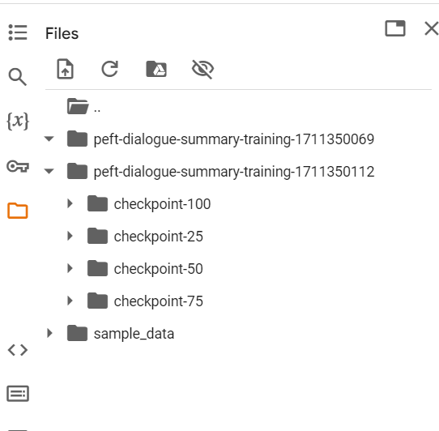
PEFT Inference

